Slide 1

6MMCS001W Mobile User Experience Lecture
jQuery Mobile UI ● jQuery Mobile basic anatomy

Slide 2

jQuery Mobile UI

Slide 3
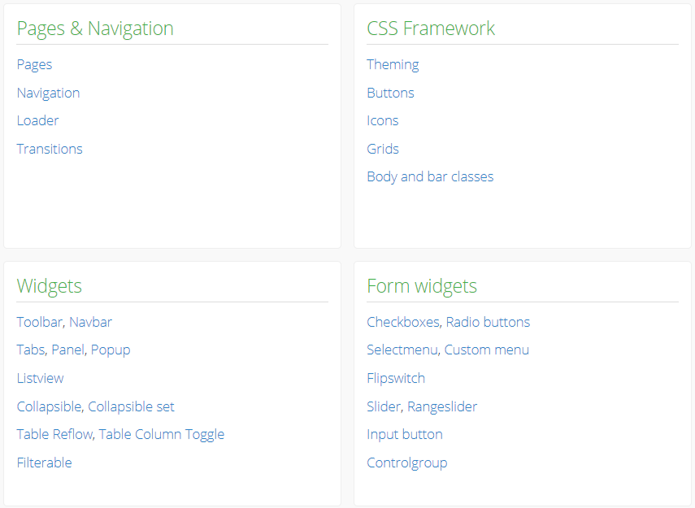
Demo of jQuery Mobile UI elements

Slide 4
jQuery mobile
A user interface framework based on jQuery that works across all popular phones, tablet, e-reader, and desktop platforms.
Built with accessibility and universal access in mind, we follow progressive enhancement and responsive web design (RWD) principles.
HTML5 Markup-driven configuration makes it easy to learn, but a powerful API makes it easy to deeply customize the library.

Slide 5
jQuery Mobile basic pages anatomy

Slide 6
HTML5 document
<!DOCTYPE html>
<html>
<head>
<meta charset="utf-8">
<title>jQuery Mobile Page</title>
</head>
<body>
</body>
</html>

Slide 7

jQuery, Mobile + Theme CSS [URL]
<!DOCTYPE html>
<html>
<head>
<meta charset="utf-8">
<title>jQuery Mobile Page</title>
<meta name="viewport" content="width=device-width, initial-scale=1">
<!-- the three things that jQuery Mobile needs to work -->
<link rel="stylesheet" href="http://code.jquery.com/mobile/1.4.5/jquery.mobile-1.4.5.min.css">
<script src="https://code.jquery.com/jquery-2.2.4.min.js"></script>
<script src="http://code.jquery.com/mobile/1.4.5/jquery.mobile-1.4.5.min.js"></script>
<!-- <script src="http://code.jquery.com/jquery-1.9.1.min.js"></script> -->
</head>
Check latest versions on jQuery Mobile Website

Slide 8
jQuery, Mobile + Theme CSS [locally defined]
<!DOCTYPE html>
<html>
<head>
<meta charset="utf-8">
<title>jQuery Mobile Page</title>
<meta name="viewport" content="width=device-width, initial-scale=1">
<!-- the three things that jQuery Mobile needs to work -->
<link rel="stylesheet" href="../jquery.mobile-1.4.5/jquery.mobile-1.4.5.css" />
<script src="../jquery-1.11.0.js" type="text/javascript"></script>
<script src="../jquery.mobile-1.4.5/jquery.mobile-1.4.5.js" type="text/javascript"></script>
</head>
Check latest versions on jQuery Mobile Website

Slide 9
Data-role=“page”
<body>
<!-- This is page 1-->
<div data-role="page" id="Page1">
<!-- jQuery Mobile page content goes here -->
</div> <!-- /page -->
</body>

Slide 10
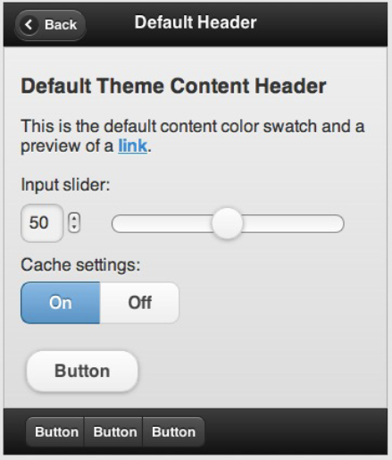
Page data-roles
<div data-role="page">
<div data-role="header">...</div>
<div role="main" class="ui-content">...</div>
<div data-role="footer">...</div>
</div>
header
content
footer

Slide 11
Simple content
<div data-role="page">
<div data-role="header">
<h1>Page Title</h1>
</div><!-- /header -->
<div role="main" class="ui-content">
<p>Page content goes here.</p>
</div><!-- /content -->
<div data-role="footer">
<h4>Page Footer</h4>
</div><!-- /footer -->
</div>
<!-- /page -->
</body>

Slide 12
jQuery Mobile Navigation

Slide 13
Connecting pages
<body>
<!-- This is page 1-->
<div data-role="page" id="Page1">
<div data-role="header"><h1>Page 1</h1></div>
<div role="main" class="ui-content">
<p>This is the content for page 1 with a <a href="#Page2">link to page 2</a></p>
</div>
<div data-role="footer"><h1>Footer</h1></div>
</div>
<!-- This is page 2-->
<div data-role="page" id="Page2">
<div data-role="header"><h1>Page 2</h1></div>
<div role="main" class="ui-content">
<p>This is the content for page 2 with a <a href="#Page1">link to page 1</a>
</div>
<div data-role="footer"><h1>Footer</h1></div>
</div>
</body>

Slide 14
Reading
Jason Beaird (2014) The Principles of Beautiful Web Design, 3 edition, SitePoint. [E-Resource]
Budiu, R. & Nielsen, J. (2016) User Experience for Mobile Applications and Websites, 3rd edition, Nielsen Norman Group. [E-Resource]
Chapters 2, 3 & 4, Michal Levin (2014) Designing Multi-Device Experiences: An Ecosystem Approach to User Experiences across Devices, O'Reilly Media, page 96.
Chapters 1, 2, 6 & 7, Suzanne Ginsburg (2010) Designing the iPhone User Experience: A User-Centered Approach to Sketching and Prototyping iPhone Apps, Addison-Wesley Professional, ISBN 0-321-69943-2
O’Brien: Get Ready for the Decade of Gamification. San Jose Mercury News. October 24, 2010, available at: http://goo.gl/4XQp2c, last accessed on 19/04/2016.
iOS Human Interface Guidelines
https://developer.apple.com/library/ios/documentation/UserExperience/Conceptual/MobileHIG/
Notes:
In what setting the marble voice mail machine would be usable?

